Slide 1
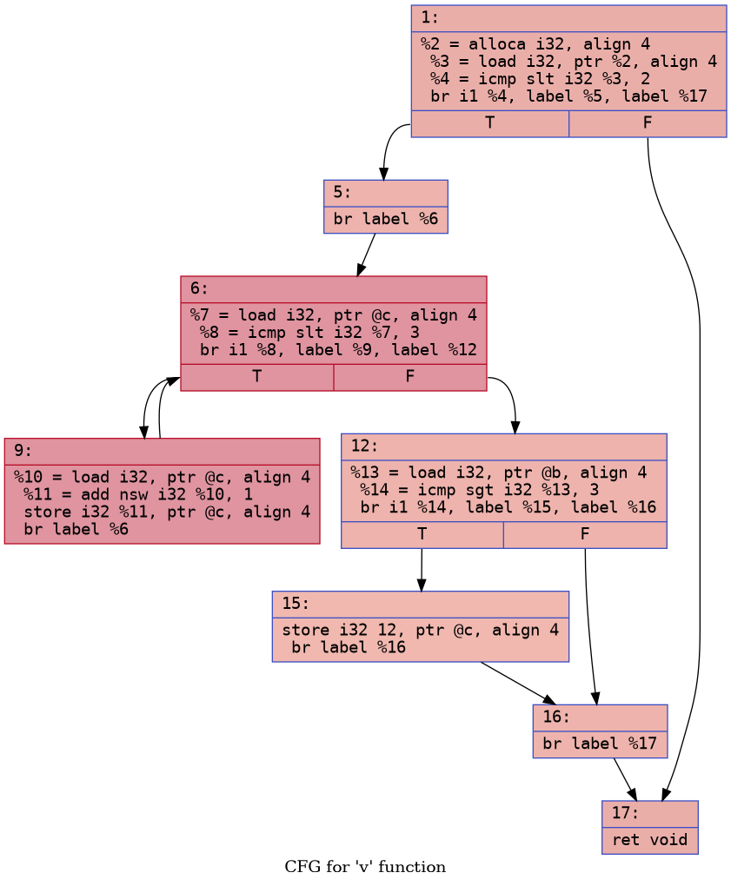
Exercise #9
Static Analysis Review
Use path notation to indicate one path (or set of paths) through this CFG:
1

Slide 2
CodeQL
“a language and toolchain for code analysis”
EECS 677: Software Security Evaluation
Drew Davidson
Guest: Dominic Tassio

Slide 3
Administrivia
And
Announcements
Drew is not here
A little about me…

Slide 4
Last time
Continued Rice’s Theorem discussion
  “All non-trivial semantic properties of programs are undecidable.”
Program Guarantees
  “Provide assurances about what a program will NEVER or ALWAYS do”
Analysis Over CFGs
  Building/Notating/Visualizing/Overapproximating Reachability

Slide 5
Today’s Roadmap
What is CodeQL?
What is CodeQL used for?
How to use CodeQL
Live* Demo

Slide 6
What is CodeQL?

Slide 7
First, Semmle
CodeQL was originally a product from Semmle, Inc.
Acquired by GitHub/Microsoft in September 2019
Made free for open source and research
Now integrated directly with GitHub and as a vscode extension

Slide 8
CodeQL Now
“a language and toolchain for code analysis”
CodeQL allows for code to be queried like a database
Provides a “standard library” of queries to discover vulnerabilities, measure code quality, or to mix and match

Slide 9
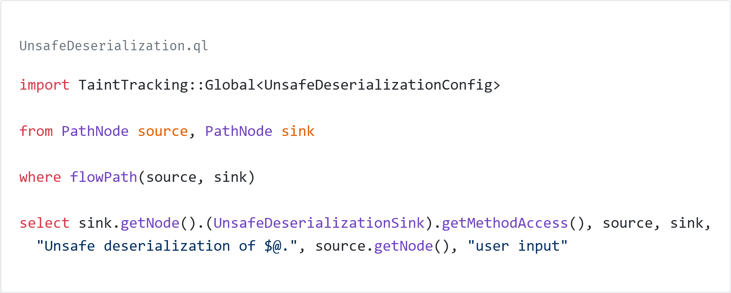
A language

Slide 10
What is CodeQL used for?

Slide 11
Supported Languages
Language | Variants | Compilers
C/C++ | C89, C99, C11, C17, C23, C++98, C++03, C++11, C++14, C++17, C++20, C++23 | Clang, GCC, MSVC, armcc
C# | .NET 5, .NET 6, .NET 7, .NET 8, .NET 9, .NET 10
GitHub Actions
Go | up to 1.27
Java | to 26 | javac, ecj
Kotlin | .8.0 to 2.4.20 | Kotlin compiler
JavaScript | ECMAScript 2022 or lower
Python | 2.7, 3.5, 3.6, 3.7, 3.8, 3.9, 3.10, 3.11, 3.12, 3.13, 3.14
Ruby | up to 3.3
Rust | editions 2021 and 2024 | Rust compiler
Swift | 5.4 to 6.3 | Swift compiler
TypeScript | 2.6 to 7.0

Slide 12
Supported Frameworks
Language | Framework
C# | ASP.NET, ASP.NET Core, ASP.NET Razor, Dapper, EntityFramework, Json.NET, NHibernate, WinForms
Go | beego, Chi, Couchbase, Echo, Gin, glog, go-pg, go-restful, go-sh, go-spew, GoKit, Gokogiri, goproxy, goxpath, htmlquery, jsonpatch jsonquery, protobuf, sqlx, xmlpath, xmlquery, xpath, yaml, zap, …
Java/Kotlin | Guava, Hibernate, Jackson, JSON-java, JDBC, protobuf, String, …
JavaScript/TypeScript | angular, axios, ejs, electron, express, fastify, handlebars, hapi, hogan, jquery, lodash, mustashe, mysql, nest.js, react, request, squelize, socket.io, sqlite3, swig, underscore, vue, …
Python | Django, FastAPI, Flask, Twisted, httpx, requests, urllib, urllib2, urllib3, simplejson, toml, ujson, psycopg2, sqlite3, SQLAlchemy, libxml2, …
Ruby | Faraday, http_client, httparty, nokogiri, open-uri, posix-spawn, rubyzip, …
Rust | Actix-web, alloc, biscotti, clap, cookie, digest, futures, hyper, libc, log, md5, mysql, mysql, once_cell, poem, postgres, rand, regex, reqwest, rocket, rustls, sqlx, tokio, url, warp, …
Swift | Alamofire, CryptoKit, CryptoSwift, Foundation, GRDB, JavaScriptCore, libxml2, Network, SQLite3, UIKit, WebKit, …

Slide 13
Data Flow
Computing the possible values that a variable can hold at various points in a program

Slide 14
Range Analysis
Determine the upper or lower bounds on an expression, or whether an expression could potentially over or underflow

Slide 15
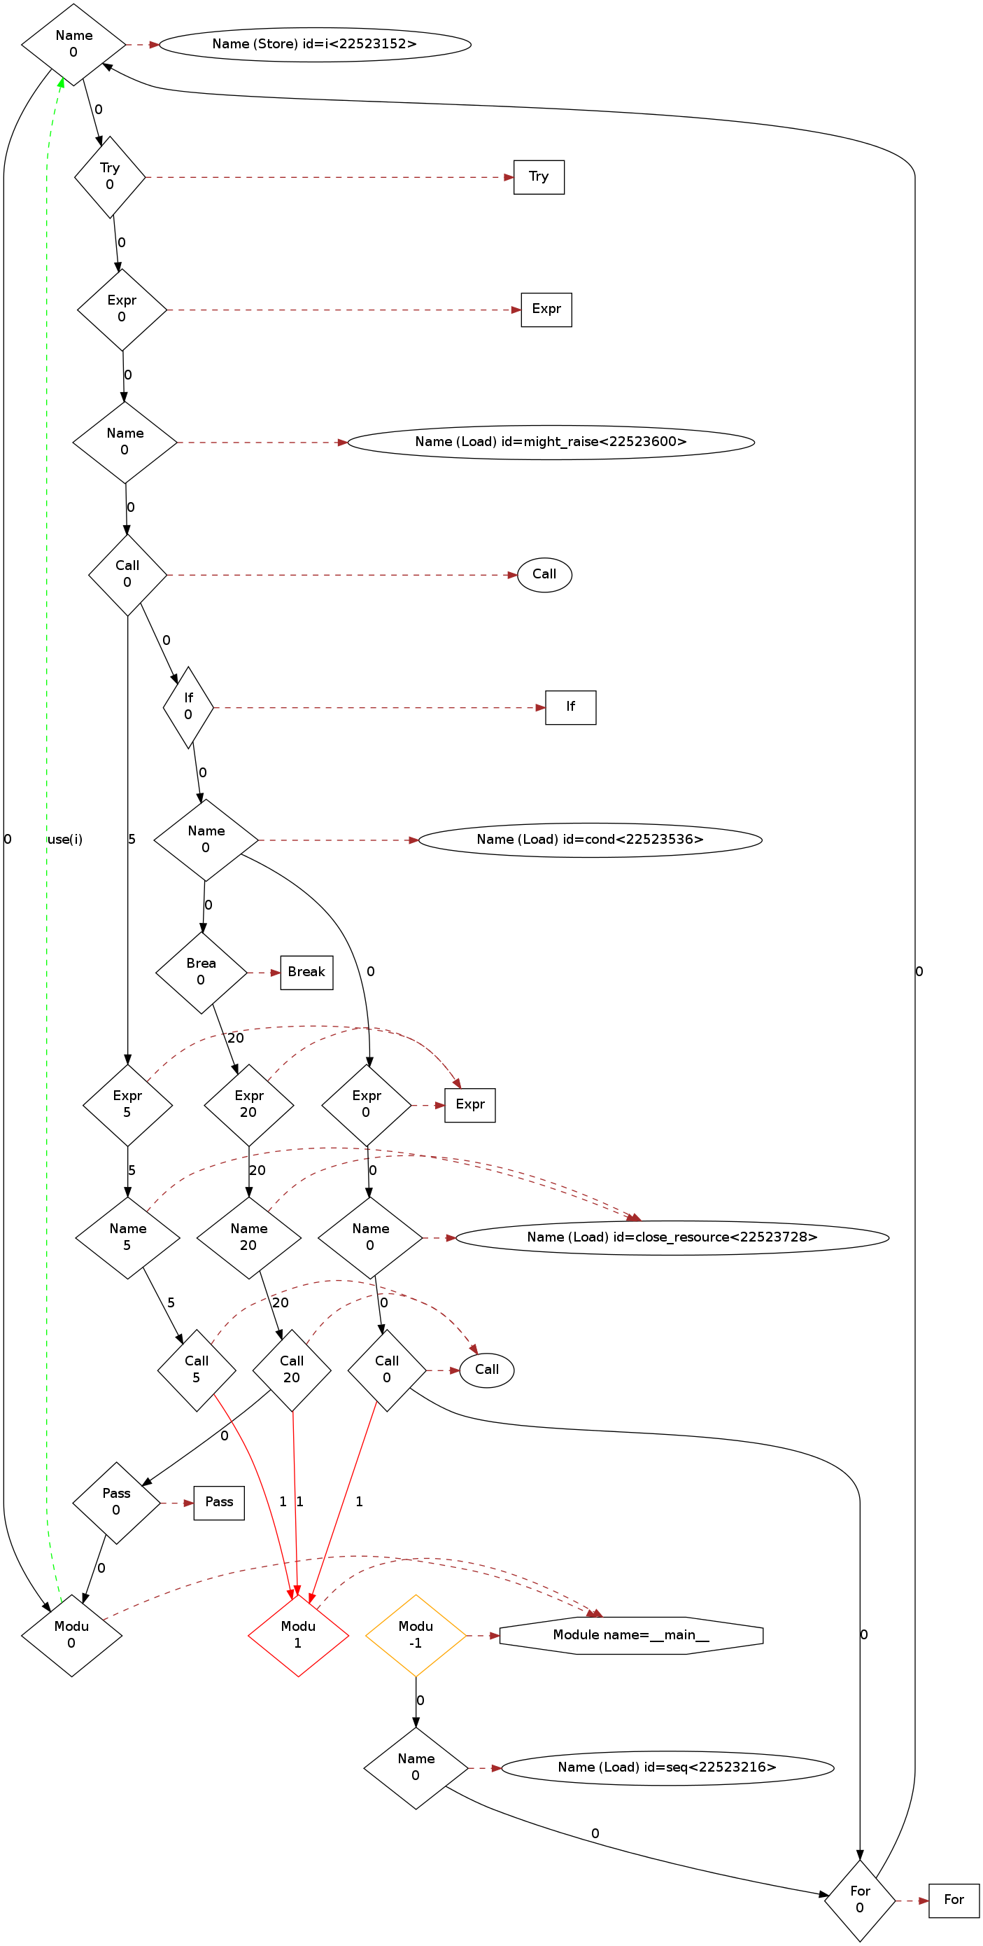
Analyze Control Flow
Explore the control flow graph of a program
Discover unreachable code or mutually exclusive blocks of code

Slide 16
Navigate the Call Graph
Identifying code that calls other code, and code that can be called from elsewhere
Find methods that are never used

Slide 17
Detecting Buffer Overflow
Detect potential buffer overflows by checking for allocations

Slide 18
How to use CodeQL?

Slide 19
1. Build the database
CodeQL does not operate directly on the program source
A database needs to be generated using the source code before analysis can begin

Slide 20
2. Write a query
Using the CodeQL query language, write a query to run the analysis that you’re interested
Or use a built-in or preexisting query

Slide 21
3. Run the query
Once you have the database created and the query written, run the query

Slide 22
4. Inspect the results
CodeQL supports several outputs for both human and machine consumption

Slide 23
Live Demo

